Slide 1
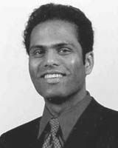
Firm-specific, industry-specific, and occupational human capital and the sourcing of knowledge work
Kyle J. Mayer, Deepak Somaya, & Ian O. Williamson
Organization science. Sep/Oct 2012, Vol. 23(5), p1311-1329
Re-revised by Bryn Choi, Spring 2023
(original by Julie Ao and revised by Tom DeBerge and Deepika Chhillar)

Slide 2
Research Question and Purpose
Research Question: What drives heterogeneity in firm capabilities?
Purpose: “In this paper, we examine how these differential firm capabilities may arise and in turn influence outsourcing decisions, especially in the context of knowledge work” (Mayer, Somaya, & Williamson, 2012: 1). Prior ‘make-or-buy’ (governance) decisions give rise to specific capabilities that then influence future governance decisions.
Past Governance Choices
Future Governance Choices
Internalizing
Internalizing
Different Firm Capabilities
Outsourcing
Outsourcing

Slide 3
Contributions
Develops a human capital-centered framework of capability development and sourcing decisions in knowledge work.
Focuses on the functional level of human capital [HC], the primary ‘location’ of firm knowledge and capabilities (Grant 1996; Felin & Hesterly, 2007)
Emphasizes two central logics: impact of prior governance choices on HC; impact on governance choices on different incentive structures between firms
Considers contingencies that impact process of HC accumulation
Uses project-level patent data

Slide 4
Theory/Model
Linking TCE (governance) and RBV (capabilities) literature by considering how governance leads to development of capabilities, namely human capital.
Human Capital (Becker 1964)
Managerial Rents Model (Castanias & Helfat 1991, 2001)
Knowledge Sourcing Choice
Firm specific
Industry specific
General
Occupational
Notes:
Human Capital: investments in human capital include such factors as educational level, on-the-job skills training, health care, migration, and consideration of issues regarding regional prices and income. Taking into account varying cultures and political regimes, the research indicates that economic earnings tend to be positively correlated to education and skill level.
Managerial Rents Model: Managerial resources, defined as the skills and abilities of managers, are important contributors to the entire bundle of firm resources that enable some firms to generate rents. Three main types of managerial human capital that underlie firm capabilities.

Slide 5
Three Types of Human Capital (Castanias & Helfat, 1991)
Firm-Specific Human Capital: Knowledge and skills that are unique to the firm (e.g., knowledge about specific strategies, processes, and technologies of the firm).
Industry-Specific Human Capital: Knowledge about the industry setting or domain in which a project is situated and is re-deployable across a set of firms with projects in the same industry.
Occupational (General) Human Capital: Knowledge and skills required to perform work within a professional or functional area, often easily transferred across different industries and firm settings.

Slide 6
Hypothesis 1 (Firm-Specific)
H1: Firms are less likely to outsource knowledge projects the greater their relevant firm-specific human capital developed by performing prior related projects internally.
External suppliers’ disadvantages
(Grant 1996; Kogut & Zander 1992, 1996)
Time compression diseconomies
(Dierickx & Cool 1989, Knott et al. 2003)
Governance inseparabilities
(Argyres & Liebeskind 1999)
Inter-Organizational Learning [relatedly, but not explicitly, Transactional Value (Zajac and Olsen, 1993)] (Mayer & Argyres, 2004)

Slide 7
Hypothesis 2 (Industry-specific)
H2: Firms are less likely to outsource knowledge projects the greater the relevant industry-specific human capital developed by previously internalizing knowledge projects in the same domain.
Suppliers withhold knowledge from client
Difficult to learn industry-specific human capital
(Darr et al. 1995, Argote & Ingram 2000)
Learning by doing (i.e., through internalization)
(Hatch & Dyer 2004)

Slide 8
Hypothesis 3 (Firm/Industry interaction)
H3: The marginal impact of higher firm-specific or industry-specific human capital on the tendency of firms to internalize knowledge work is highest when the other type of human capital (firm-specific or industry-specific) is low.
Relevance of both types of HC for an activity
One is high, another is low:
Increased capability to the knowledge work
Coordination benefits of using internal HC
Marginal benefits when firm- or industry- HC is high and the other increases

Slide 9
Hypothesis 4 (Occupational)
H4: Firms are more likely to outsource knowledge projects situated in areas that are highly contested (and thus rely heavily on occupational human capital)
Firm cannot replicate specialized suppliers’ incentives and, therefore, capability development
Competition creates incentives to use external occupational HC
Negative consequences of potential errors are large
Perceived gains from using expert occupational HC are large

Slide 10
Hypothesis 5 (Contingency)
H5: The larger the firm’s internal staff (in the focal occupational area), the weaker the (positive) effect of a project being in a highly contested area on the probability of outsourcing (i.e., the size of the firm’s internal staff negatively moderates the effect of being in a highly contested area on outsourcing).
Larger internal staff lower outsourcing
Organize more efficiently as a hierarchy better incentive structure
(Garicano 2000, Garicano & Rossi-Hansberg 2006)
Occupational HC within the firm increases the absorptive capacity for knowledge
(Cohen & Levinthal 1990)

Slide 11
Data Sample
129 public U.S. firms in the 1989 Fortune 500 survey in technology-based industries
Industry includes, chemicals; computer manufacturing; electronics; pharmaceuticals; scientific and photographic equipment
Patents that were filed and obtained (patent prosecution) during 1990-1995
Core sample of 80,129 patents

Slide 12
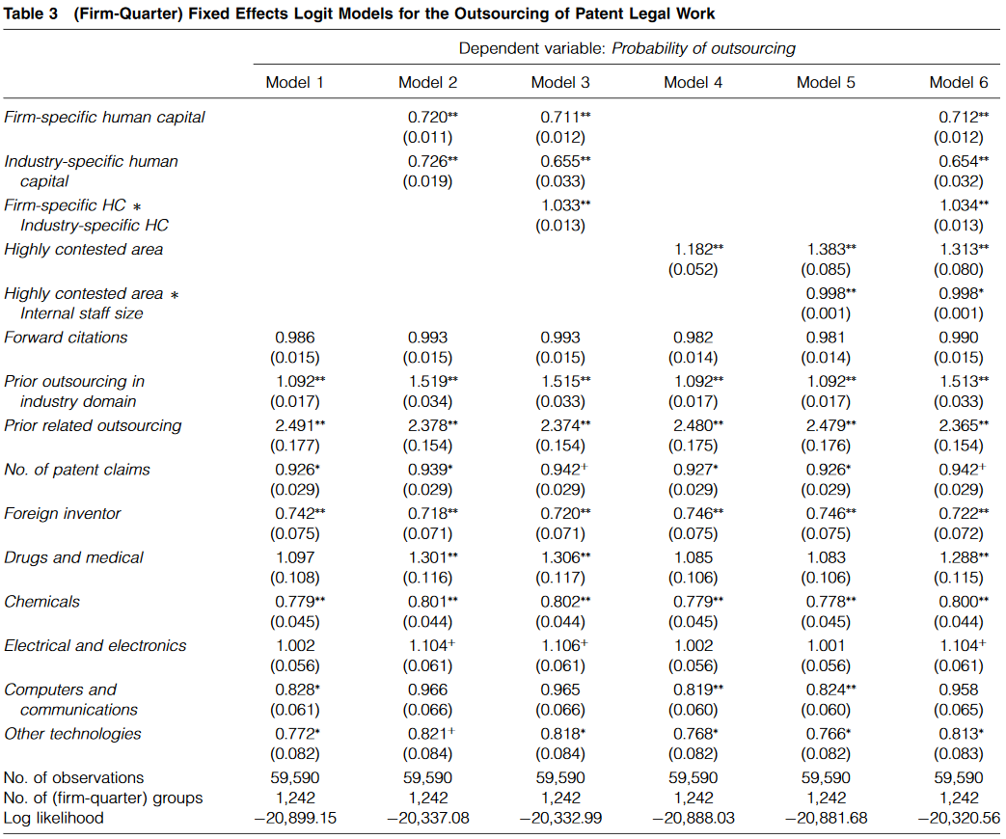
H1 and H2 corroborated
H3 corroborated
H4 corroborated
H5 corroborated

Slide 13
Conclusion
Findings suggest the organizations should carefully consider the long-term effects of their outsourcing decisions.
A firm’s governance choices are not only based on minimizing transaction costs, but also building block for the firm’s stock of human capital.
Summary of Contributions:
Extends Castanias and Helfat’s (1991, 2001) framework of firm-specific, industry-specific, and general HC by focusing on occupational HC as a subset of general HC
Demonstrates how governance choices impact HC-based capability development, which influences knowledge sourcing decisions
Integrates TCE (governance) and RBV (capabilities)
Employs detailed project-level data from patent prosecution work

Slide 14
Discussion
Chicken or Egg: Do governance choices come ‘first’ or do capabilities? (In other words, the process is still not well understood, and this paper considers a relatively short time span. When do the paths begin to diverge and why?).
What are some of the limitations of using internalized patent prosecution (that is, the work of drafting, filing, and obtaining patents) to measure human capital?

